Slide 1
Data binding
Developer's guide to Windows 10 Insider Preview
Andy & Jerry

Slide 2
Data binding basics
Compiled binding

Slide 3

Data binding basics

Slide 4
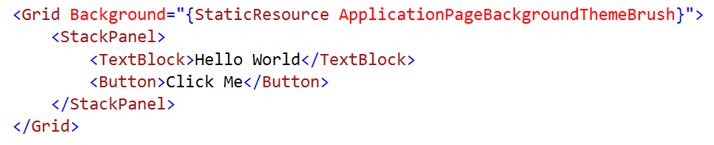
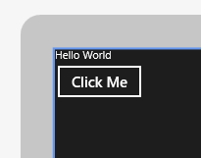
Literal Data
You could hard code everything, but…
Not very dynamic.

Slide 5
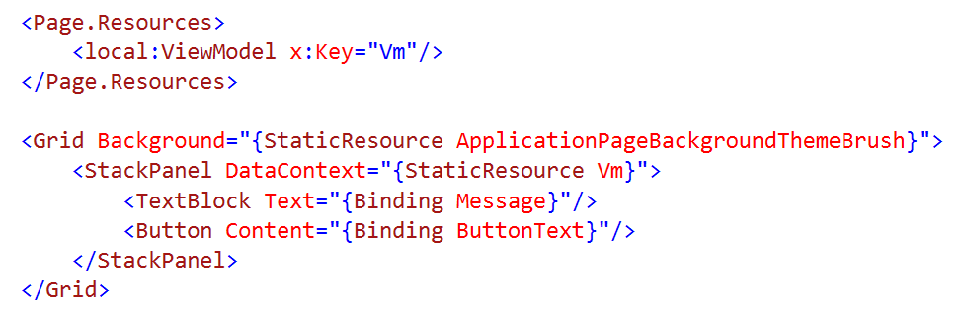
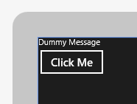
Dynamic Data
Use data binding to connect to a data source
Typical data source would be a view model

Slide 6
Updating the UI
INotifyPropertyChanged
Implement in a view model class
Raised by View Model when property value changes
INotifyCollectionChanged
Implemented in ObservableCollection<T> and ReadOnlyObservableCollection<T>
Raised by the collection when the collection is modified
(also IObservableVector)

Slide 7
New for dependency properties register for property changes

Slide 8
Syntax
<TextBox Text="{Binding
Converter
ConverterLanguage
ConverterParameter
ElementName
FallbackValue
Mode
Path
RelativeSource
Source
TargetNullValue
UpdateSourceTrigger}

Slide 9
Converting Data
Converters change data during binding
Raw datatype > Converter > Formatted string
IValueConverter
Convert method
Converts data to a new format/value before assignment
ConvertBack method
Converts data from the new format/value updating source
Often not implemented

Slide 10
Classic binding

Slide 11
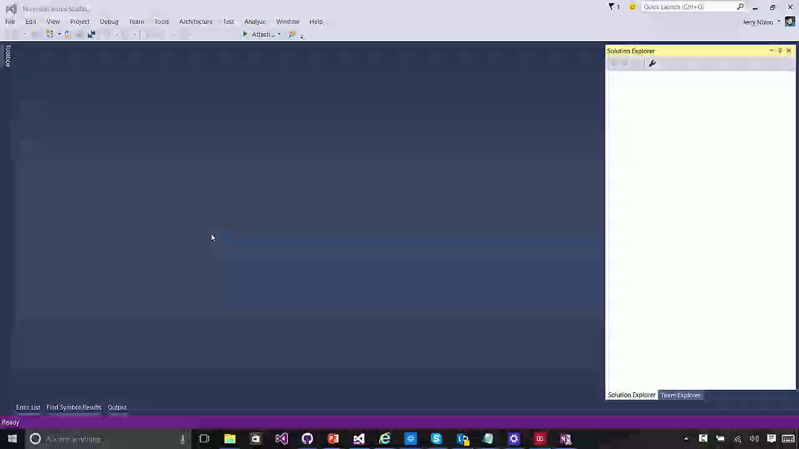

Slide 12
Data bind to models or data bind to elements

Slide 13
ElementName

Slide 14
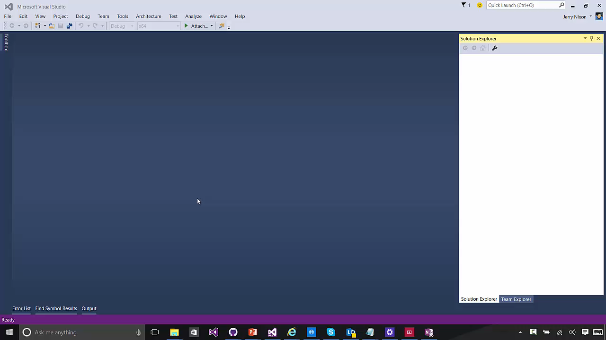

Slide 15

Compiled binding

Slide 16
What problem are we solving?

Slide 17
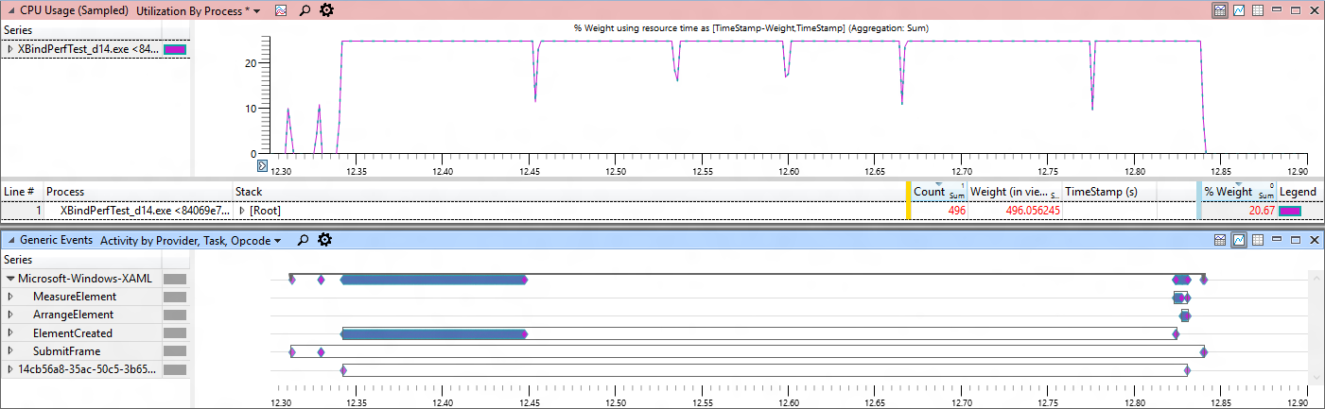
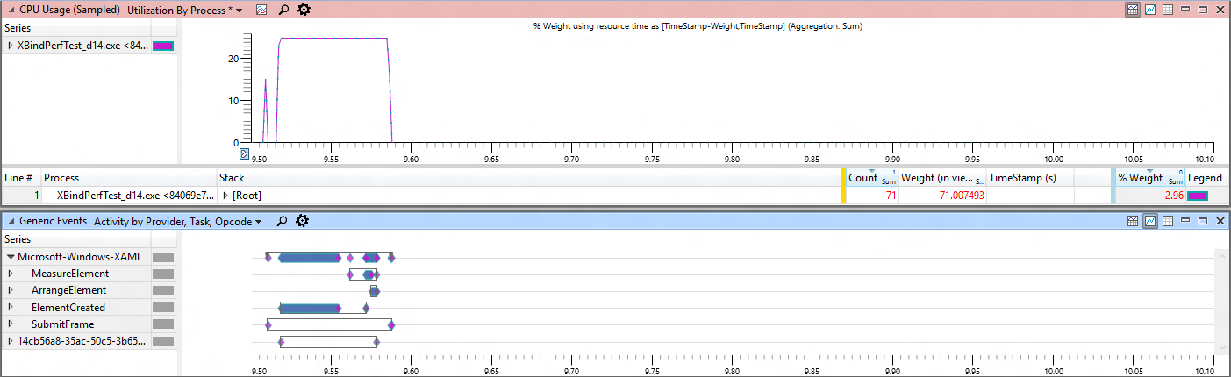
Classic Binding
Compiled Binding

Slide 18
x:Bind
Compiled binding
Bindings are committed at compile-time
Strongly-typed binding
Duck binding is not supported
Default mode is OneTime
OneWay and TwoWay are still available
Standard binding approaches
INotifyPropertyChanged, IObservableVector, INotifyCollectionChanged

Slide 19
The data context of x:Bind is the code-behind class

Slide 20
Syntax
<TextBox Text="{Binding
Converter
ConverterLanguage
ConverterParameter
ElementName
FallbackValue
Mode
Path
RelativeSource
Source
TargetNullValue
UpdateSourceTrigger}
<TextBox Text="{x:Bind
Converter
ConverterLanguage
ConverterParameter
ElementName
FallbackValue
Mode
Path
RelativeSource
Source
TargetNullValue
UpdateSourceTrigger}

Slide 21
Data Templates
<ListView ItemsSource="{x:Bind ViewModel.Employees}">
<ListView.ItemTemplate>
<DataTemplate x:DataType="model:Employee">
<Grid>
<TextBlock Text="{x:Bind Name}"/>
</Grid>
</DataTemplate>
</ListView.ItemTemplate>
</ListView>

Slide 22
Compiled binding

Slide 23
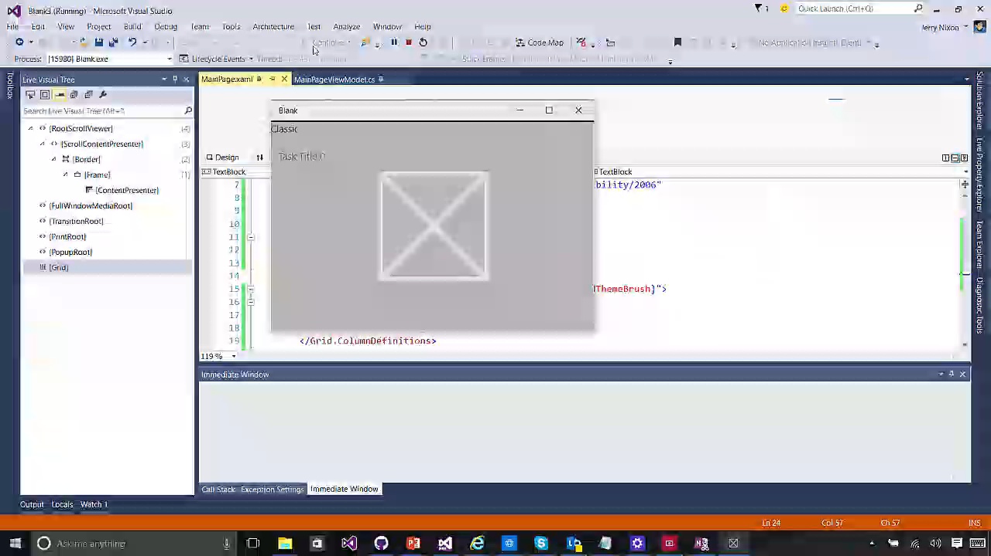

Slide 24
Syntax differences
<ListView ItemsSource="{Binding Items}" Header="Classic" Grid.Column="0">
<ListView.ItemTemplate>
<DataTemplate>
<TextBlock Text="{Binding Title}" />
</DataTemplate>
</ListView.ItemTemplate>
</ListView>
<ListView ItemsSource="{x:Bind ViewModel.Items}" xmlns:m="using:Blank3.Models"
Header="Compiled" Grid.Column="1">
<ListView.ItemTemplate>
<DataTemplate x:DataType="m:TodoItem">
<TextBlock Text="{x:Bind Title}" />
</DataTemplate>
</ListView.ItemTemplate>
</ListView>

Slide 25
Improve performance by simplifying your templates

Slide 26
Resource dictionaries
<ResourceDictionary
x:Class="MyNamespace.MyTemplates"
xmlns:model="using:xBindSampleModel">
<DataTemplate
x:Key="MyTemplate"
x:DataType="model:Employee">
<TextBlock Text="{x:Bind Name}" />
</DataTemplate>
</ResourceDictionary>
namespace MyNamespace
{
public class MyTemplates
{
public MyTemplates()
{
InitializeComponent();
}
}
}

Slide 27
Use Bindings.Update() for async data

Slide 28
Referencing a dictionary
</UserControl.Resources>
<ResourceDictionary>
<ResourceDictionary.MergedDictionaries>
<local:MyTemplates/>
<ResourceDictionary Source="filename" />
</ResourceDictionary.MergedDictionaries>
</ResourceDictionary>
</UserControl.Resources>

Slide 29
Use Bindings.Update() for async data (incl. OneTime)

Slide 30
Binding for Events
<Button Click="PokeEmployee">Poke Employee</Button>
<Button Click="{x:Bind Employee.Poke}">Poke Employee</Button>
Signature
Have no parameters - void Poke()
Match event parameters - void Poke(object sender, RoutedEventArgs e)
Match event base types - void Poke(object sender, object e)
Overloading is not supported
Because all events are eligible:
This may replace ICommand & EventToCommand
Note: this does not include parameter or CanExecute

Slide 31
Bindings.StopTracking() pauses compiled bindings

Slide 32
How do I?
RelativeSource = Self & ElementName
Reference elements by name in Text="{x:Bind MyElement.Text}"
RelativeSource = TemplatedParent
Cannot use x:Bind in control templates; TemplateBinding is already optimized
UpdateSourceTrigger = PropertyChanged
There is UpdateSourceTrigger with x:Bind
Source / DataContext
Add a ViewModel to your code-behind

Slide 33
Page.ViewModel
public sealed partial class MainPage : Page
{
public MainPage()
{
InitializeComponent();
this.DataContextChanged += (s, e) =>
{
ViewModel = DataContext as ViewModels.MainPageViewModel;
};
}
// strongly-typed view models enable x:bind
public ViewModels.MainPageViewModel ViewModel { get; set; }
}

Slide 34
{x:Bind} is not for every situation (yet)

Slide 35
When to use classic binding
Duck Typing
Text=“{Binding Age}” works for both PersonModel & WineModel
Dictionary graphs
Use {Binding} with JSON or other untyped objects
Code-behind binding
Can add/remove {x:Bind} @ runtime
Use in a style
{x:Bind} can’t be used in a style for setters
{x:Bind} can be used in a DataTemplate that is defined in the style

Slide 36
x:Bind can meet your binding needs most of the time.

Slide 37
Data binding basics
Compiled binding

